Slide 1
리눅스 커널 파일 시스템 실습 2 myfs, minfs
15 Feb 2022
IN HO SONG
mearrong123@gmail.com

Slide 2
Chapter Objectives
linux-kernel-labs filesystem [gitblog][github]
Exercise(linux/tools/labs)
VM setup (QEMU)
myfs
register/unregister myfs
completing myfs superblock
Initialize myfs root inode
myfs mount/unmount

Slide 3
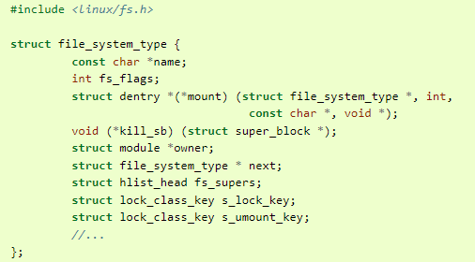
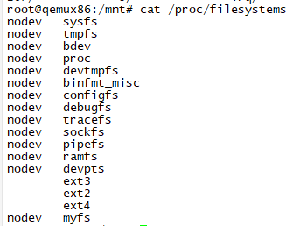
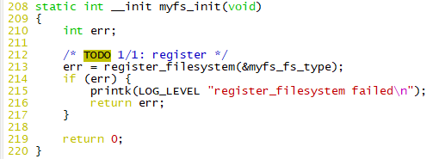
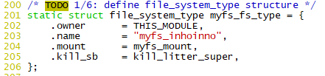

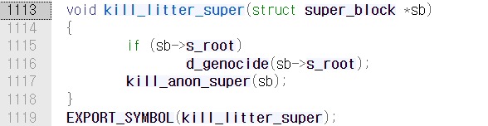
Linux Kernel Labs : Filesystem “myfs”
TODO 1 : register/unregister filesystem
tools/labs$ make clean
tools/labs$ LABS=filesystems make skels
tools/labs/skel/filesystem/myfs$ vim myfs.c
[myfs_init] register_filesystem
/include/linux/fs.h : struct file_system_type
[file_system_type] myfs_fs_type
myfs.c 208 : register_filesystem(&myfs_fs_type)
tools/labs$ make build
tools/labs$ make copy
tools/labs$ make boot
myfs.c 200 : myfs_fs_type
.mount : read super from disk in mem
.kill_sb : release super from mem
void kill_litter_super
https://elixir.bootlin.com/linux/v5.10.7/source/fs/super.c#L1113
static struct file_system_type

Slide 4
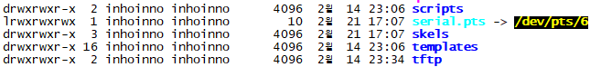

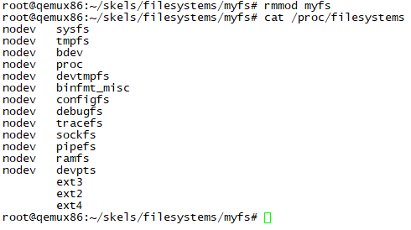
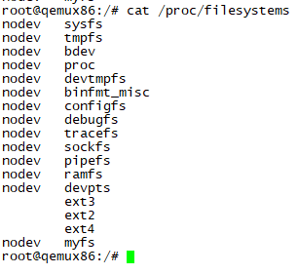
Linux Kernel Labs : Filesystem “myfs”
(another terminal)
tools/labs$ ls –la
…
tools/labs$ minicom –D serial.pts
(…)
# qemu login : root
# cd /skels/filesystems/myfs
~/skels/filesystems/myfs# insmod myfs.ko
# cat /proc/filesystems
myfs
static struct file_system_type

Slide 5
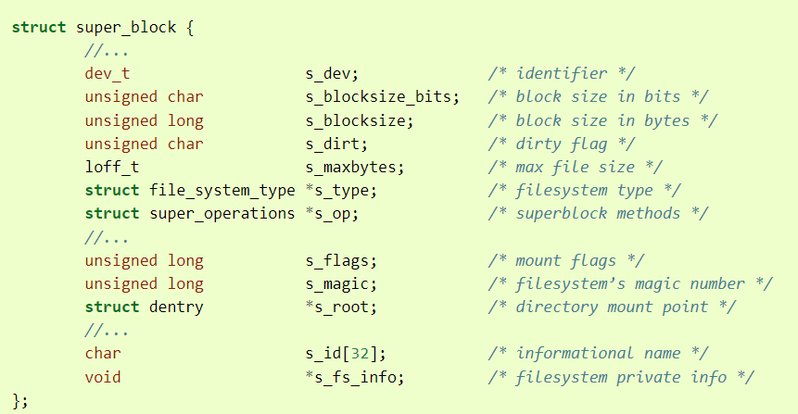
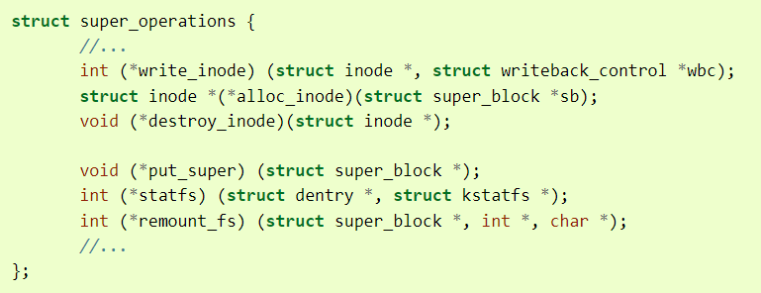
Linux Kernel Labs : Filesystem “myfs”
TODO 2 : completing myfs superblock fill_super()
/include/linux/fs.h:1935 struct super_operations
/include/linux/fs.h:1416 struct super_block

Slide 6
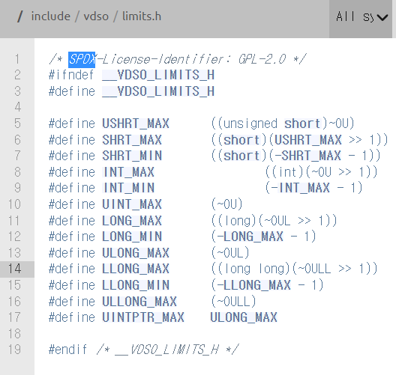
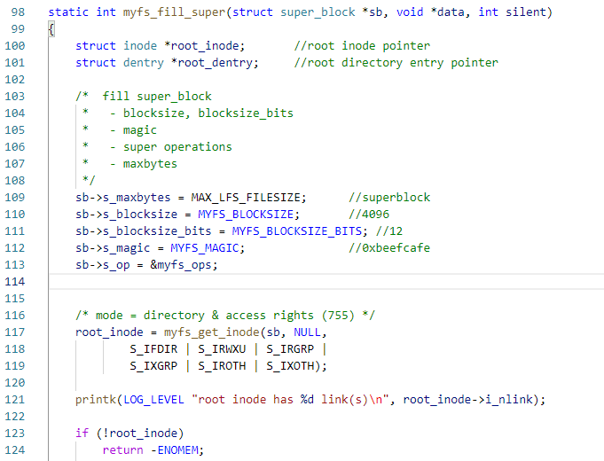
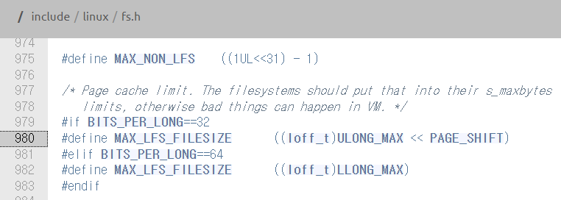

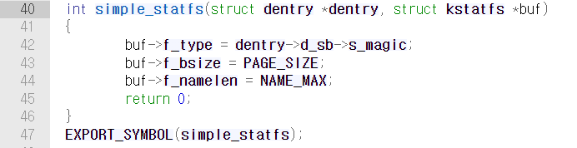
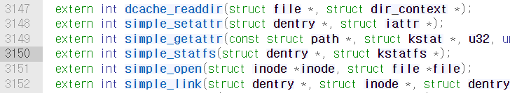
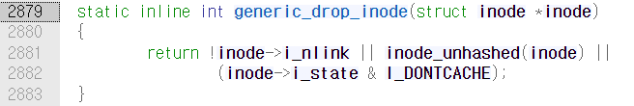
Linux Kernel Labs : Filesystem “myfs”
TODO 2 : completing myfs superblock fill_super()
tools/labs/skel/filesystem/myfs$ vim myfs.c
/include/linux/fs.h:980 MAX_LFS_FILESIZE
/*Page cache limit. The filesystem should put that into their s_maxbytes limit. Otherwise bad things can happen in VM*/
/include/vdso/limits.h:14 LLONG_MAX
/fs/libfs.c:40 int simple_statfs(dentry, kstatfs)
2?
/include/linux/fs.h:3150 simple_statfs
/linux-kernel-labs/linux/tools/labs/skel/filesystem/myfs/myfs.c
1?
/include/linux/fs.h:2879 generic_drop_inode()

Slide 7
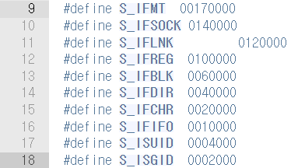
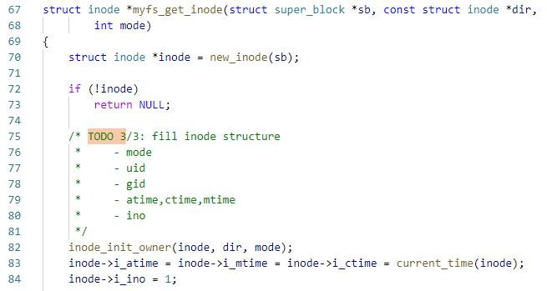
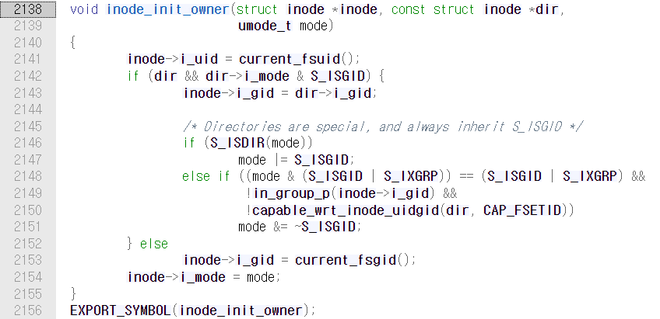
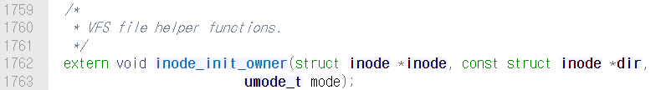
Linux Kernel Labs : Filesystem “myfs”
TODO 3 : Initialize myfs root inode
fill inode structure
set inode operations for dir inodes
directory inodes start off with i_nlink == 2 (for "." entry).
* Directory link count should be incremented (use inc_nlink).
/include/uapi/lunux/stat.h
/include/uapi/lunux/stat.h
/fs/inode.c
/linux-kernel-labs/linux/tools/labs/skel/filesystem/myfs/myfs.c
:myfs_get_inode (67~85)
/include/linux/fs.h

Slide 8

Linux Kernel Labs : Filesystem “myfs”
TODO 3 : Initialize myfs root inode
set inode operations for dir inodes
if inode && inode->i_mode has group id (S_ISGID)
NULL
/include/uapi/lunux/stat.h
/include/uapi/lunux/stat.h
/fs/inode.c
/include/uapi/lunux/stat.h
/include/linux/fs.h

Slide 9
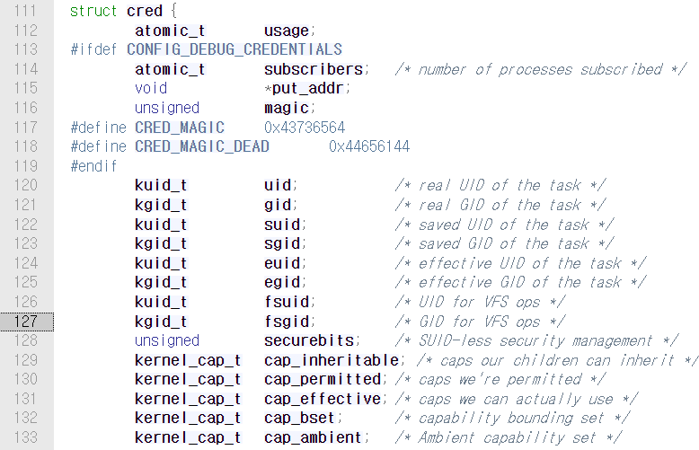
Linux Kernel Labs : Filesystem “myfs”
TODO 3 : Initialize myfs root inode
set inode operations for dir inodes
NULL
/include/linux/cred.h
/fs/inode.c
/include/linux/fs.h
/include/linux/cred.h

Slide 10
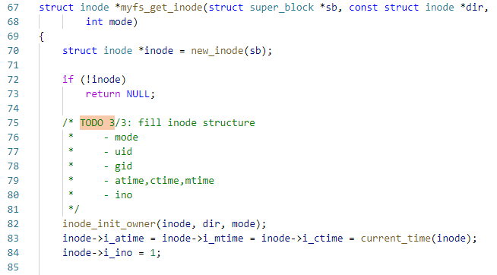
Linux Kernel Labs : Filesystem “myfs”
TODO 3 : Initialize myfs root inode
fill inode structure
set inode operations for dir inodes
directory inodes start off with i_nlink == 2 (for "." entry).
* Directory link count should be incremented (use inc_nlink).
/include/uapi/lunux/stat.h
/include/uapi/lunux/stat.h
/include/linux/cred.h
/fs/inode.c
/linux-kernel-labs/linux/tools/labs/skel/filesystem/myfs/myfs.c
:myfs_get_inode (67~85)
/include/linux/fs.h

Slide 11
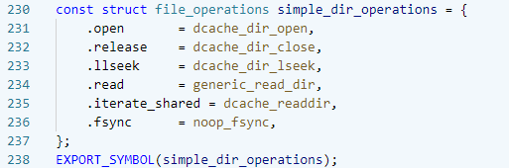
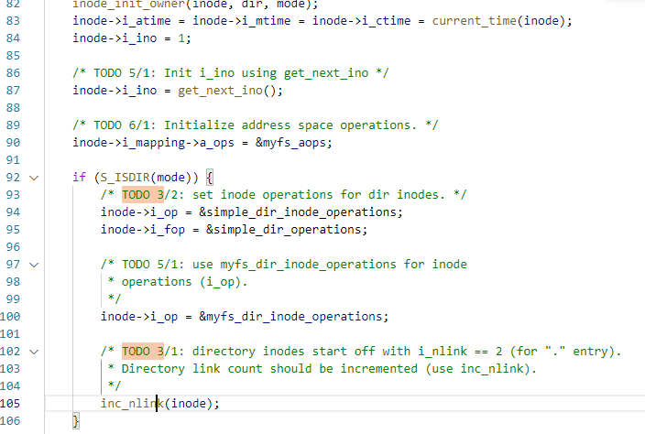

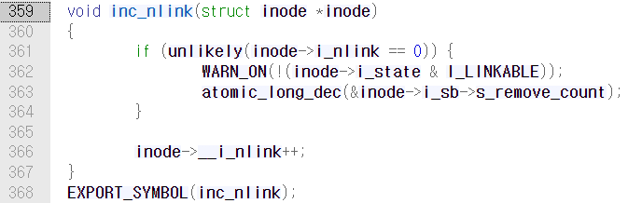
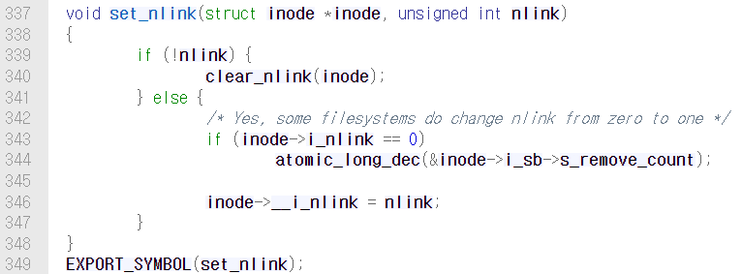
Linux Kernel Labs : Filesystem “myfs”
TODO 3 : Initialize myfs root inode
/fs/libfs.c : line 230~243
/linux-kernel-labs/linux/tools/labs/skel/filesystem/myfs/myfs.c
: line 67~85 myfs_get_inode()
/fs/inode.c : line 359
* i_nlink : the number of names entries (dentries) that use this inode;
/fs/inode.c : line 337

Slide 12
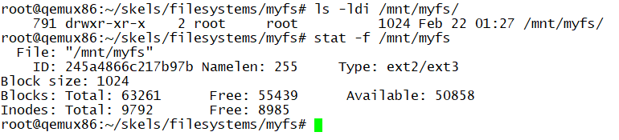
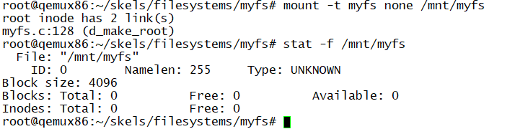
Linux Kernel Labs : Filesystem “myfs”
TODO 2 : completing myfs superblock fill_super()
TODO 3 : Initialize myfs root inode
TODO 4 : test myfs mount/unmount
$ vim myfs.c
$ make build
$ make copy
$ make boot

Slide 13


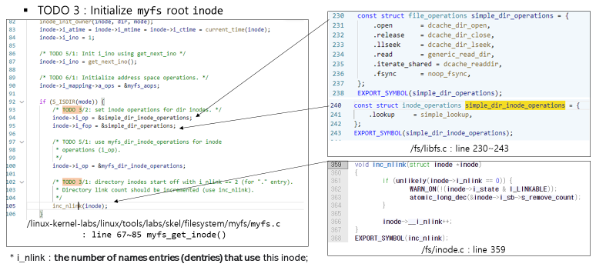
Linux Kernel Labs : Filesystem “myfs”
TODO 3 : Init myfs root inode
inc_nlink(inode)

Slide 14
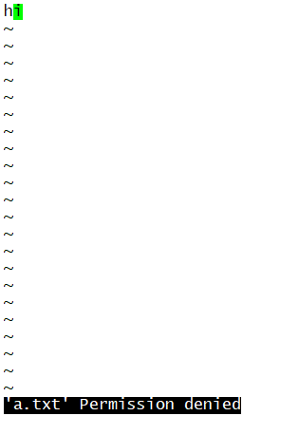
Linux Kernel Labs : Filesystem “myfs”
myfs$ vi a.txt
현재 파일 관련 operation은 구현이 안된 상태!

Slide 15
Linux Kernel Labs : Filesystem “myfs”
남은 일들
TODO 5 : inode->ino = get_next_ino, myfs_dir_inode_operations, mknod(), creat(), mkdir()
TODO 6 : struct file_operation, struct address space operation,
file inode, file operations for regular file
and so on..

